Slide 1

©2022 iCafeCloud

Slide 2

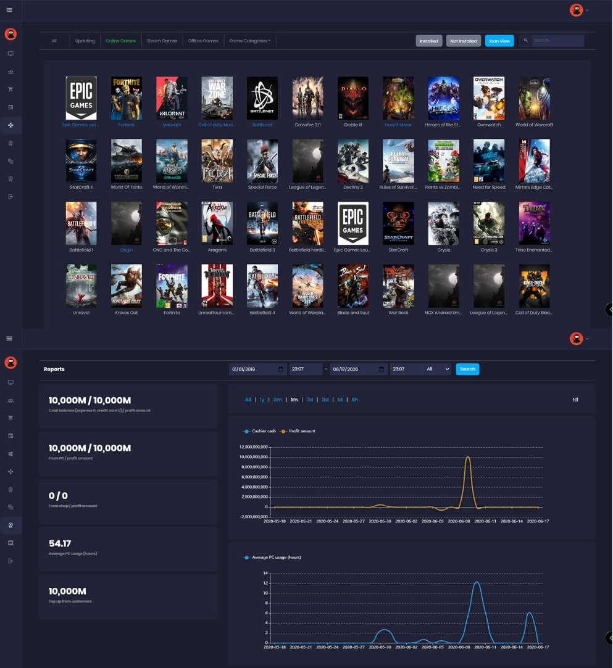
What is CafeCloud ?
iCafeCloud is a billing and game management cloud POS that empowers your game center setup with
Member Manager
Game License Manager
Competitive Leaderboards
Real Time Reporting
Multi Device Cloud Access
Custom Client Interfaces
1 Click Crypto Mining
Rewards and Loyalty Bonuses
And a lot more…

Slide 3
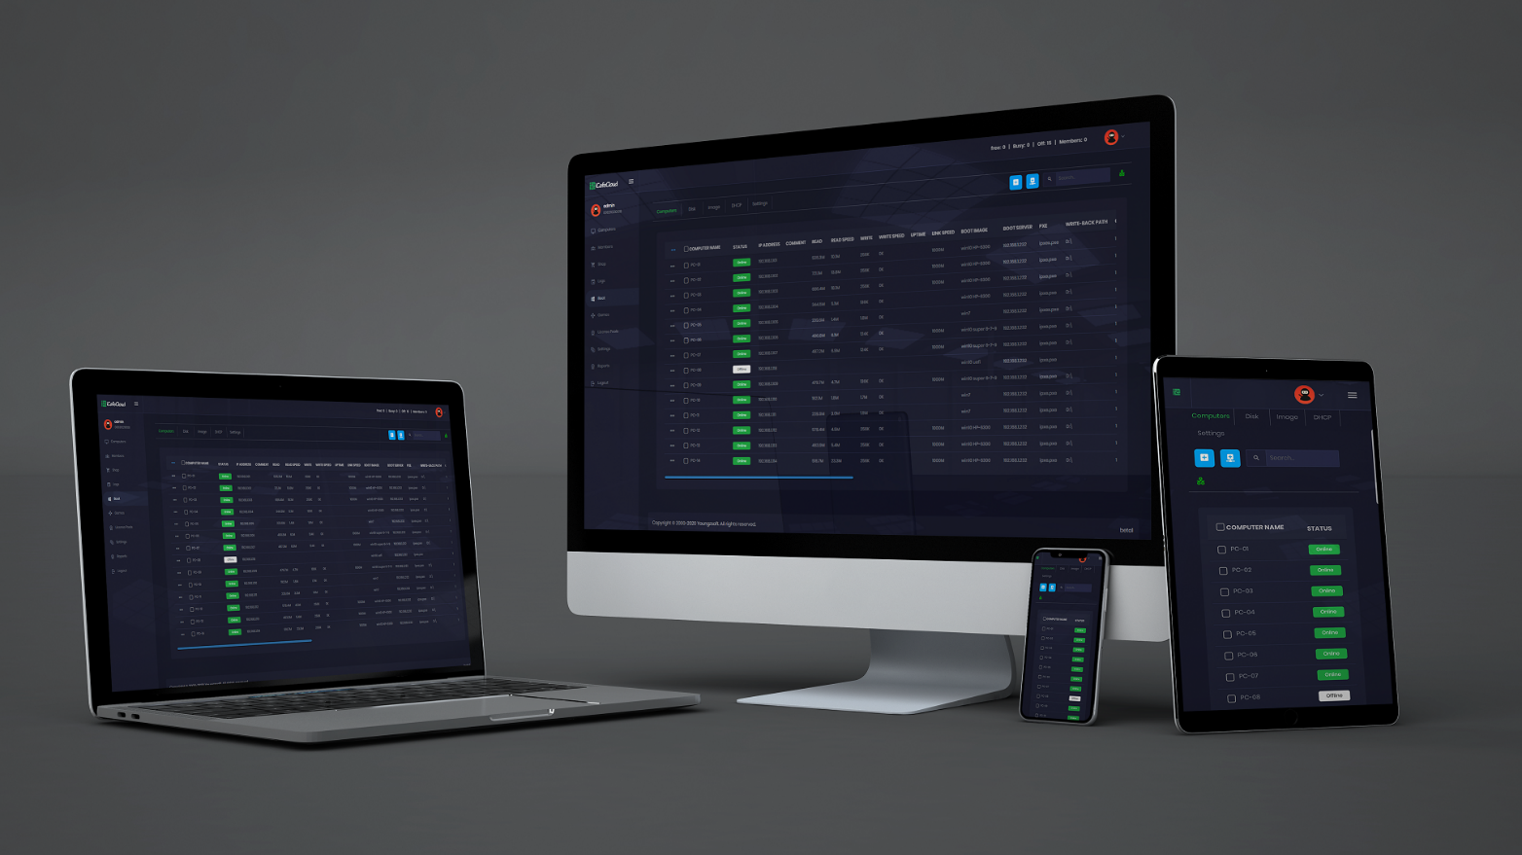
Management Interface
iCafeCloud’s management interface
can be accessed
by
any device with internet access

Slide 4
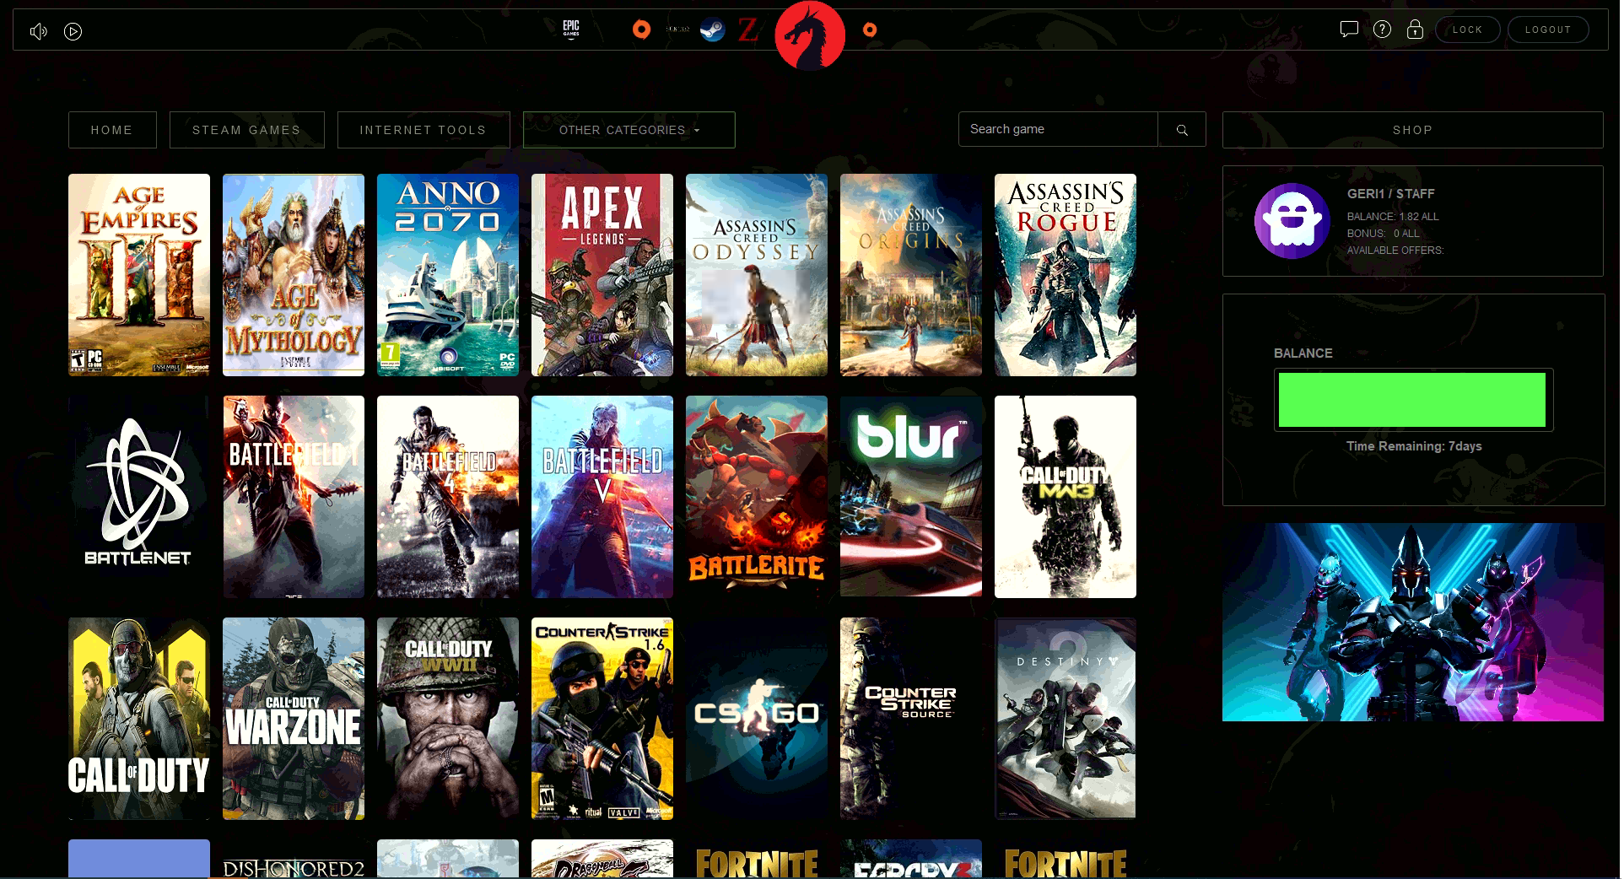
Client Interface
Favorite games
Active games
Client shop
Modern interface
Customer info

Slide 5
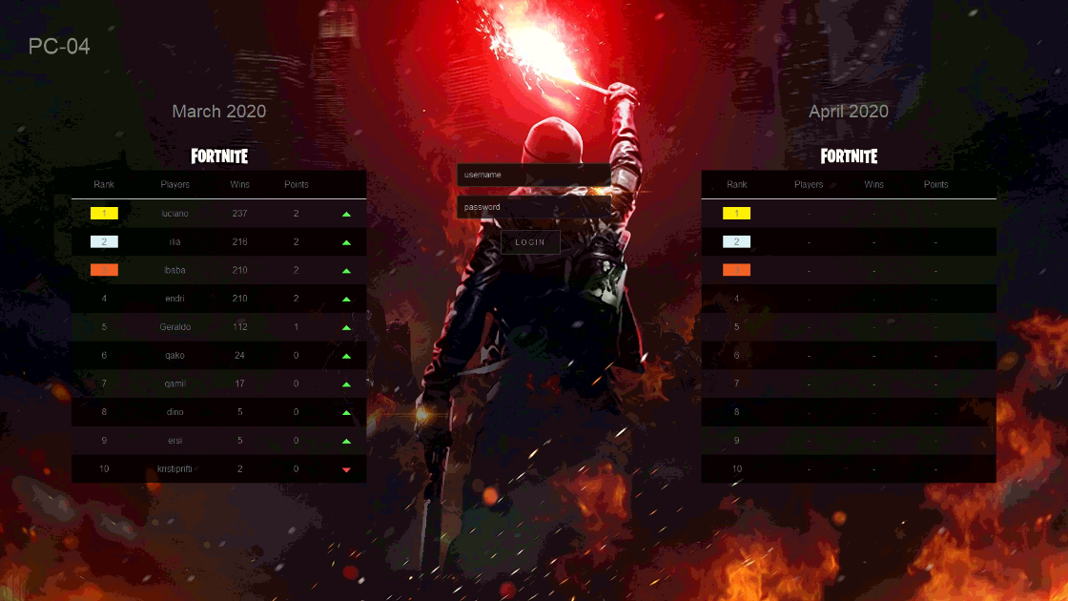
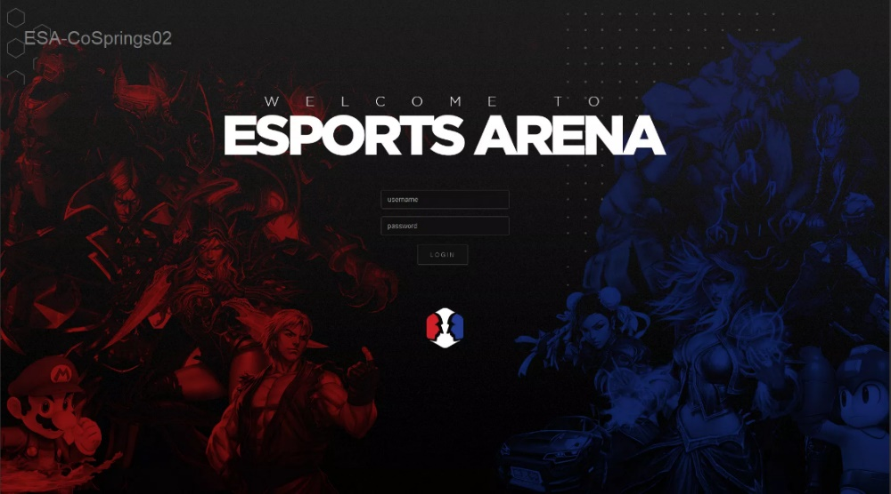
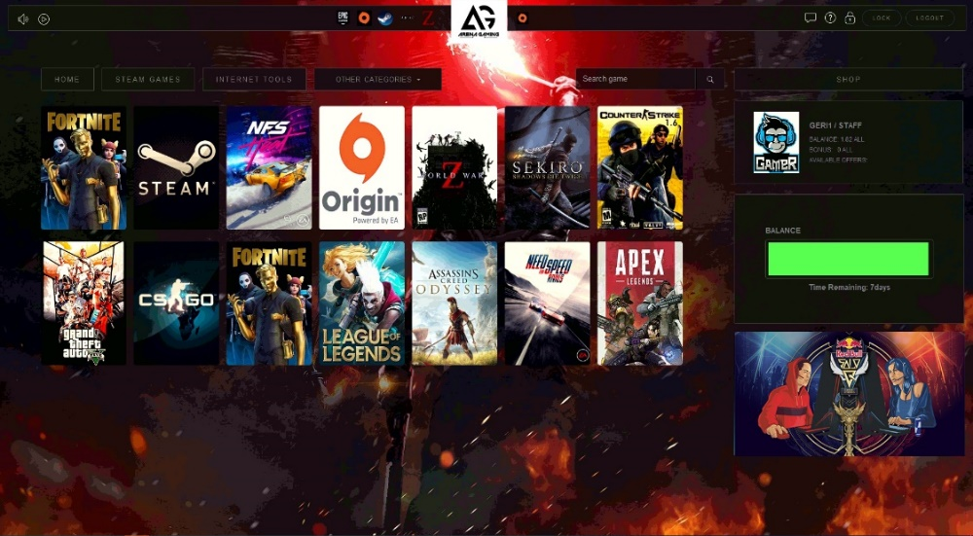
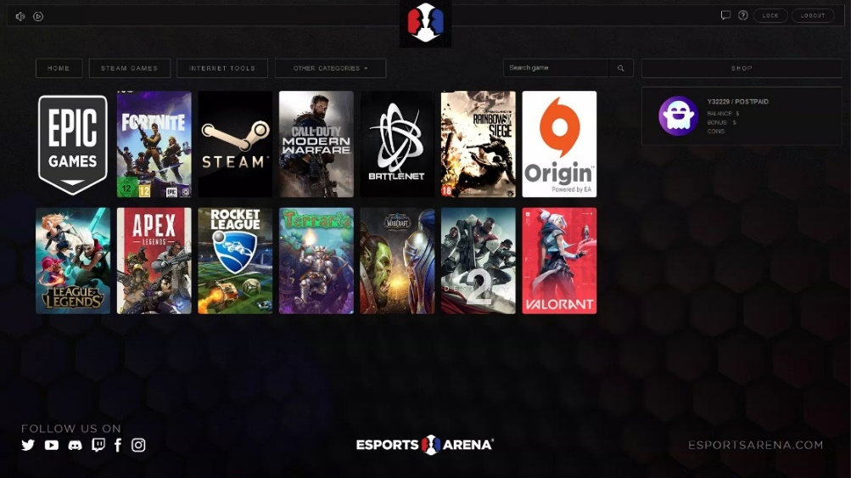
Customized Client Interface
Easily change styles & themes to match your brand identity

Slide 6
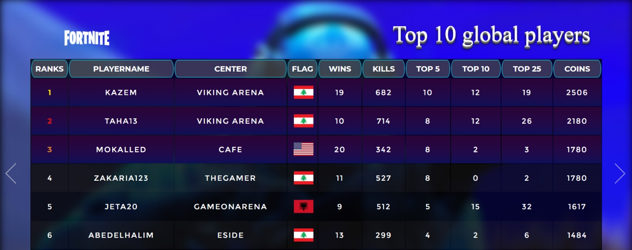
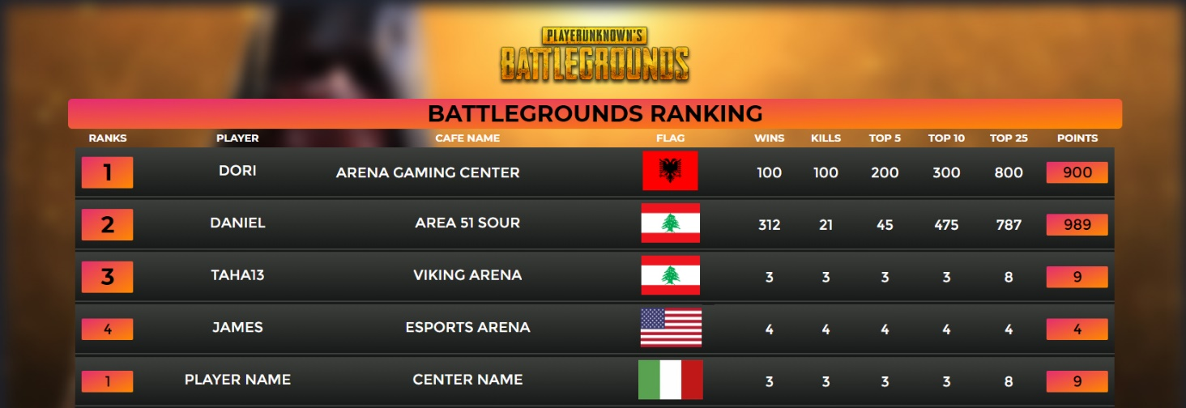
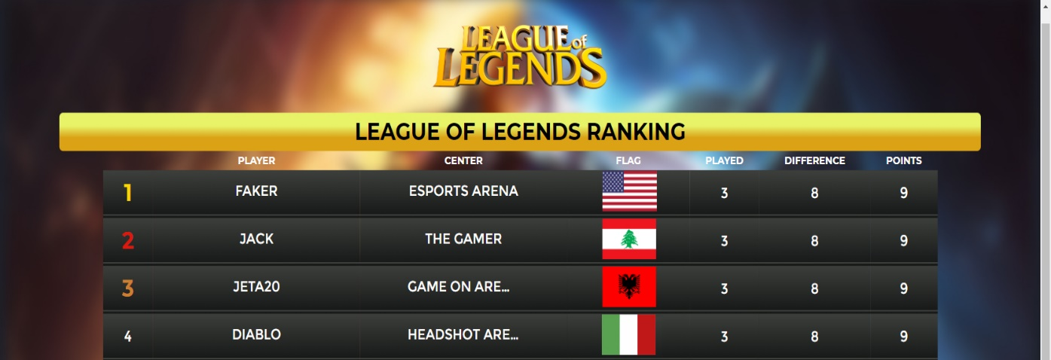
Competitive Leaderboards
In store game rankings are tracked across your entire player base

Slide 7



Value Added Features
1
Local Leaderboards can be used to build a more competitive user environment at your LAN center
2
With Loyalty Point Bonuses, Customers are bound to make you their first choice!
3
With Dedicated servers for game updates, you never have to worry about manually updating any game, ever!

Slide 8



About US
At Youngzsoft as a whole, we have been committed to creating future proof server and network based software and related services for more than 20 years.
Our goal with iCafeCloud is simple, save your costs as well as time and provide you with a one shot solution to every pain point that comes your way when running a game center setup.
Youngzsoft Co., Ltd.
Room 1620, Yannian Shijia
299 Renmin East Road
Changsha, Hunan, China 410016
P: +86-731-85537391
E: @HelpDesk
W: https://www.icafecloud.com/

